Slide 1
SSZG 518: Database Design and Applications
Today’s Class
Static Hash indexes
Dynamic Hash indexes
Extendible, Linear indexes

Slide 2
Static Hashing
A bucket is a unit of storage containing one or more records (a bucket is typically a disk block).
In a hash file organization we obtain the bucket of a record directly from its search-key value using a hash function.
Hash function h is a function from the set of all search-key values K to the set of all bucket addresses B.
Hash function is used to locate records for access, insertion as well as deletion.
Records with different search-key values may be mapped to the same bucket; thus entire bucket has to be searched sequentially to locate a record.

Slide 3
Static Hashing
# primary pages fixed, allocated sequentially, never de-allocated; overflow pages if needed.
h(k) mod M = bucket to which data entry with key k belongs. (M = # of buckets)
h(key) mod N
0
2
key
h
N-1
Primary bucket pages
Overflow pages
Notes:
3

Slide 4
Static Hashing (Contd.)
Buckets contain data entries.
Hash fn works on search key field of record r. Must distribute values over range 0 ... M-1.
h(key) = (a * key + b) usually works well.
a and b are constants; lots known about how to tune h.
Long overflow chains can develop and degrade performance.
Extendible and Linear Hashing: Dynamic techniques to fix this problem.
Notes:
4

Slide 5
Example of Hash File Organization
Hash file organization of instructor file, using dept_name as key (See figure in next slide.)
There are 8 buckets,
The binary representation of the ith character is assumed to be the integer i.
The hash function returns the sum of the binary representations of the characters modulo 8
E.g. h(Music) = 1 h(History) = 2 h(Physics) = 3 h(Elec. Eng.) = 3

Slide 6

Example of Hash File Organization
Hash file organization of instructor file, using dept_name as key (see previous slide for details).

Slide 7
Hash Functions
Worst hash function maps all search-key values to the same bucket; this makes access time proportional to the number of search-key values in the file.
An ideal hash function is uniform, i.e., each bucket is assigned the same number of search-key values from the set of all possible values.
Ideal hash function is random, so each bucket will have the same number of records assigned to it irrespective of the actual distribution of search-key values in the file.
Typical hash functions perform computation on the internal binary representation of the search-key.
For example, for a string search-key, the binary representations of all the characters in the string could be added and the sum modulo the number of buckets could be returned. .

Slide 8
Handling of Bucket Overflows
Bucket overflow can occur because of
Insufficient buckets
Skew in distribution of records. This can occur due to two reasons:
multiple records have same search-key value
chosen hash function produces non-uniform distribution of key values
Although the probability of bucket overflow can be reduced, it cannot be eliminated; it is handled by using overflow buckets.

Slide 9
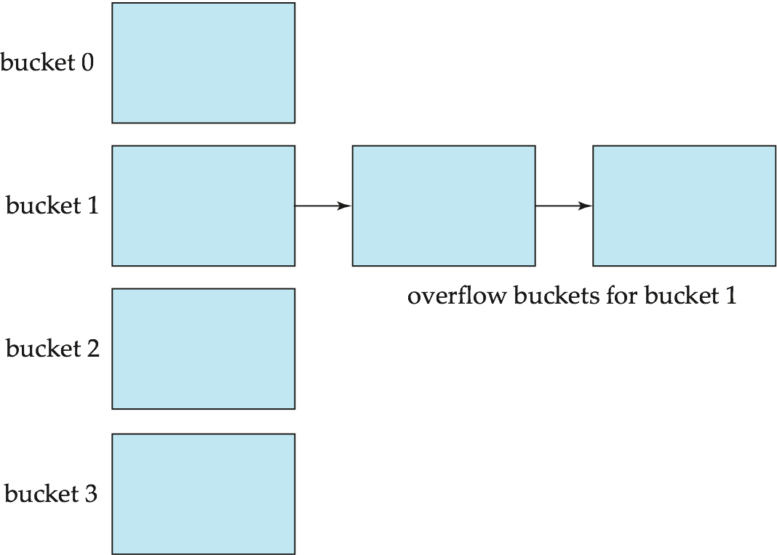
Handling of Bucket Overflows (Cont.)
Overflow chaining – the overflow buckets of a given bucket are chained together in a linked list.
Above scheme is called closed hashing.
An alternative, called open hashing, which does not use overflow buckets, is not suitable for database applications.

Slide 10
Hash Indices
Hashing can be used not only for file organization, but also for index-structure creation.
A hash index organizes the search keys, with their associated record pointers, into a hash file structure.
Strictly speaking, hash indices are always secondary indices
if the file itself is organized using hashing, a separate primary hash index on it using the same search-key is unnecessary.
However, we use the term hash index to refer to both secondary index structures and hash organized files.

Slide 11
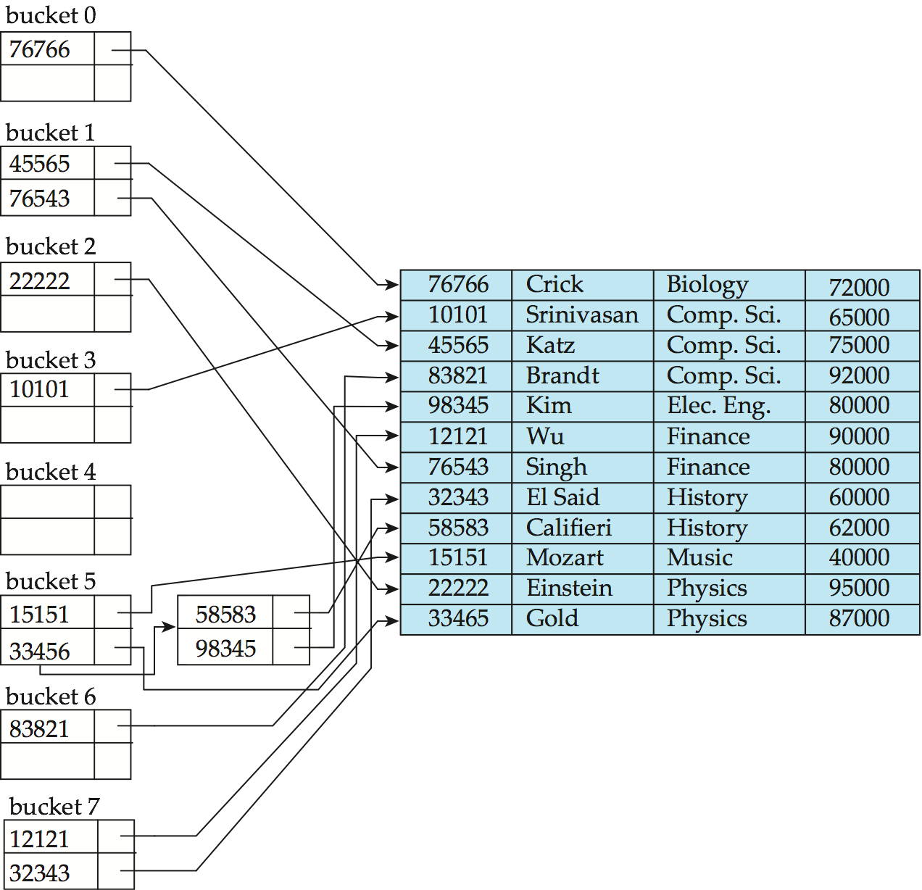
Example of Hash Index
hash index on instructor, on attribute ID

Slide 12
Deficiencies of Static Hashing
In static hashing, function h maps search-key values to a fixed set of B of bucket addresses. Databases grow or shrink with time.
If initial number of buckets is too small, and file grows, performance will degrade due to too much overflows.
If space is allocated for anticipated growth, a significant amount of space will be wasted initially (and buckets will be underfull).
If database shrinks, again space will be wasted.
One solution: periodic re-organization of the file with a new hash function
Expensive, disrupts normal operations
Better solution: allow the number of buckets to be modified dynamically.

Slide 13
Dynamic Hashing
Good for database that grows and shrinks in size
Allows the hash function to be modified dynamically
Extendable hashing – one form of dynamic hashing
Hash function generates values over a large range — typically b-bit integers, with b = 32.
At any time use only a prefix of the hash function to index into a table of bucket addresses.
Let the length of the prefix be i bits, 0 ≤ i ≤ 32.
Bucket address table size = 2^{i.} Initially i = 0
Value of i grows and shrinks as the size of the database grows and shrinks.
Multiple entries in the bucket address table may point to a bucket (why?)
Thus, actual number of buckets is < 2^{i}
The number of buckets also changes dynamically due to coalescing and splitting of buckets.

Slide 14
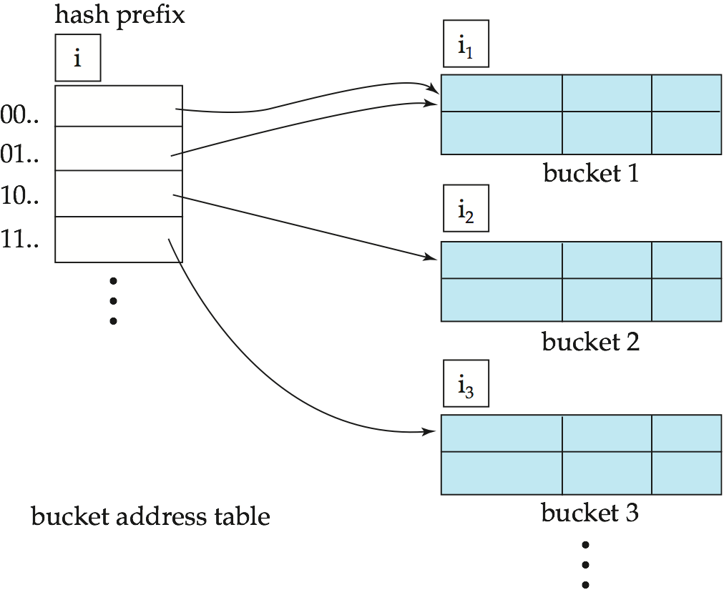
General Extendable Hash Structure
In this structure, i₂ = i₃ = i, whereas i₁ = i – 1 (see next slide for details)

Slide 15
Extendible Hashing
Situation: Bucket (primary page) becomes full. Why not re-organize file by doubling # of buckets?
Reading and writing all pages is expensive!
Idea: Use directory of pointers to buckets, double # of buckets by doubling the directory, splitting just the bucket that overflowed!
Directory much smaller than file, so doubling it is much cheaper. Only one page of data entries is split. No overflow page!
Trick lies in how hash function is adjusted!
Notes:
5

Slide 16
Example
LOCAL DEPTH
2
4*
12*
32*
16*
Bucket A
GLOBAL DEPTH
2
2
00
1*
5*
21*
13*
Bucket B
Directory is array of size 4.
To find bucket for r, take last `global depth’ # bits of h(r); we denote r by h(r).
If h(r) = 5 = binary 101, it is in bucket pointed to by 01.
01
10
2
10*
Bucket C
11
DIRECTORY
2
15*
7*
19*
Bucket D
DATA PAGES
Insert: If bucket is full, split it (allocate new page, re-distribute).
If necessary, double the directory. (As we will see, splitting a
bucket does not always require doubling; we can tell by
comparing global depth with local depth for the split bucket.)
Notes:
6

Slide 17
Insert h(r)=20 (Causes Doubling)
LOCAL DEPTH
2
3
Bucket A
LOCAL DEPTH
GLOBAL DEPTH
32*
16*
32*
16*
Bucket A
GLOBAL DEPTH
2
2
3
2
00
1*
5*
21*
13*
Bucket B
1*
5*
21*
13*
000
Bucket B
01
001
10
2
010
2
11
10*
Bucket C
011
10*
Bucket C
2
100
DIRECTORY
Bucket D
101
2
15*
7*
19*
15*
7*
19*
Bucket D
110
2
111
Bucket A2
3
4*
12*
20*
(`split image'
DIRECTORY
4*
12*
20*
Bucket A2
of Bucket A)
(`split image'
of Bucket A)
Notes:
7

Slide 18
Points to Note
20 = binary 10100. Last 2 bits (00) tell us r belongs in A or A2. Last 3 bits needed to tell which.
Global depth of directory: Max # of bits needed to tell which bucket an entry belongs to.
Local depth of a bucket: # of bits used to determine if an entry belongs to this bucket.
When does bucket split cause directory doubling?
Before insert, local depth of bucket = global depth. Insert causes local depth to become > global depth; directory is doubled by copying it over and `fixing’ pointer to split image page. (Use of least significant bits enables efficient doubling via copying of directory!)
Notes:
8

Slide 19
Extendable Hashing vs. Other Schemes
Benefits of extendable hashing:
Hash performance does not degrade with growth of file
Minimal space overhead
Disadvantages of extendable hashing
Extra level of indirection to find desired record
Bucket address table may itself become very big (larger than memory)
Cannot allocate very large contiguous areas on disk either
Solution: B⁺-tree structure to locate desired record in bucket address table
Changing size of bucket address table is an expensive operation
Linear hashing is an alternative mechanism
Allows incremental growth of its directory (equivalent to bucket address table)
At the cost of more bucket overflows

Slide 20
Linear Hashing
This is another dynamic hashing scheme, an alternative to Extendible Hashing.
LH handles the problem of long overflow chains without using a directory, and handles duplicates.
Idea: Use a family of hash functions h₀, h₁, h₂, ...
h_{i}(key) = h(key) mod(2^{i}N); N = initial # buckets
h is some hash function (range is not 0 to N-1)
If N = 2^{d0}, for some d₀, h_{i} consists of applying h and looking at the last di bits, where di = d₀ + i.
h_{i+1} doubles the range of h_{i} (similar to directory doubling)
Notes:
10

Slide 21
Linear Hashing (Contd.)
Directory avoided in LH by using overflow pages, and choosing bucket to split round-robin.
Splitting proceeds in `rounds’. Round ends when all N_{R} initial (for round R) buckets are split. Buckets 0 to Next-1 have been split; Next to N_{R} yet to be split.
Current round number is Level.
Search: To find bucket for data entry r, find h_{Level}(r):
If h_{Level}(r) in range `Next to N_{R}’ , r belongs here.
Else, r could belong to bucket h_{Level}(r) or bucket h_{Level}(r) + N_{R}; must apply h_{Level+1}(r) to find out.
Notes:
11

Slide 22
Overview of LH File
In the middle of a round.
Buckets split in this round:
Bucket to be split
If
h
(
search key value
Level
)
Next
is in this range, must use
h
(
search key value
Level+1
)
Buckets that existed at the
to decide if entry is in
beginning of this round:
`split image' bucket.
this is the range of
h
Level
`split image' buckets:
created (through splitting
of other buckets) in this round
Notes:
11

Slide 23
Linear Hashing (Contd.)
Insert: Find bucket by applying h_{Level} / h_{Level+1}:
If bucket to insert into is full:
Add overflow page and insert data entry.
(Maybe) Split Next bucket and increment Next.
Can choose any criterion to `trigger’ split.
Since buckets are split round-robin, long overflow chains don’t develop!
Doubling of directory in Extendible Hashing is similar; switching of hash functions is implicit in how the # of bits examined is increased.
Notes:
12

Slide 24
Example of Linear Hashing
On split, h_{Level+1} is used to re-distribute entries. (insert 43)
Level=0, N=4
Level=0
h
h
PRIMARY
h
h
PRIMARY
OVERFLOW
1
0
Next=0
PAGES
1
0
PAGES
PAGES
000
00
32*
44*
36*
000
00
32*
Next=1
9*
25*
5*
Data entry r
9*
25*
5*
001
01
with h(r)=5
001
01
010
10
14*
18*
10*
30*
Primary
010
10
14*
18*
10*
30*
bucket page
011
31*
35*
7*
11*
011
31*
35*
7*
11*
43*
11
11
(This info
is for illustration
only!)
(The actual contents
of the linear hashed
file)
100
00
44*
36*
Notes:
13

Slide 25
Summary
Hash-based indexes: best for equality searches, cannot support range searches.
Static Hashing can lead to long overflow chains.
Extendible Hashing avoids overflow pages by splitting a full bucket when a new data entry is to be added to it.
Directory to keep track of buckets, doubles periodically.
Can get large with skewed data; additional I/O if this does not fit in main memory.
Notes:
16

Slide 26
Summary (Contd.)
Linear Hashing avoids directory by splitting buckets round-robin, and using overflow pages.
Overflow pages not likely to be long.
Duplicates handled easily.
Space utilization could be lower than Extendible Hashing, since splits not concentrated on `dense’ data areas.
Can tune criterion for triggering splits to trade-off slightly longer chains for better space utilization.
For hash-based indexes, a skewed data distribution is one in which the hash values of data entries are not uniformly distributed!
Notes:
17

